Slide 1
Relieving the GPU: Creating a Hardware-Based Ray Tracer
Presented By: Aiden Smoot

Slide 2
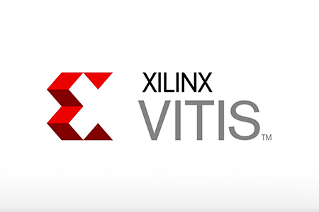
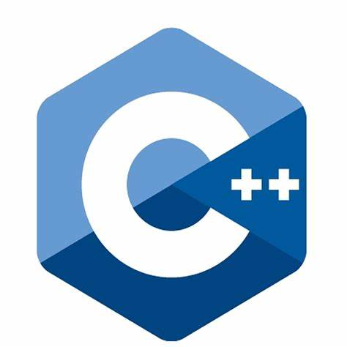
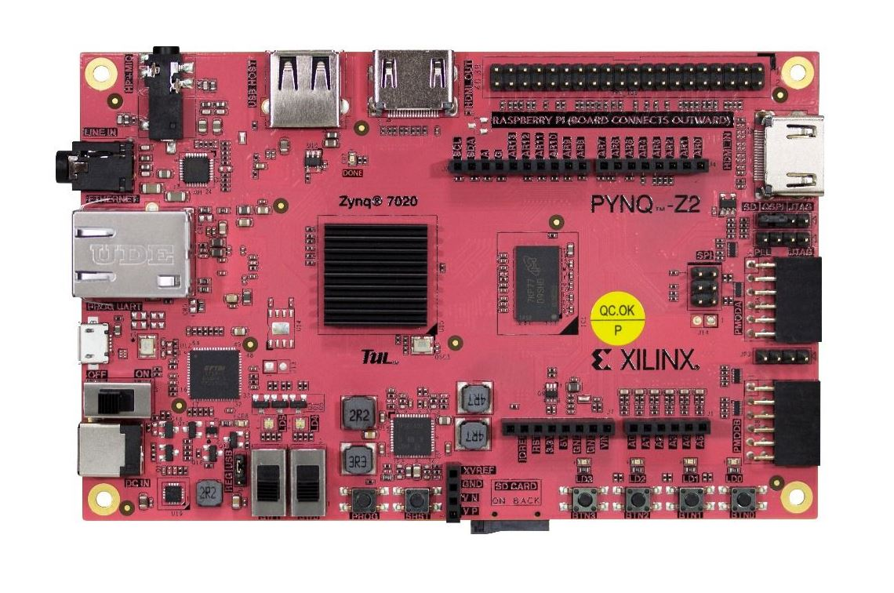

Idea
Using High Level Synthesis (HLS) to configure a Field Programmable Gate Array (FPGA) to perform Ray Tracing
tinyraytracer.cpp
FPGA Implementation
Ray Tracing High Level Code
High Level Synthesis Stages
Figure 1: Idea Flowchart [1-4]
Notes:
Why is it important?
Free up the GPU for other tasks
Accurate renderings / images
Why is it hard?
Ray tracing is computationally expensive / time consuming
Similar techniques for similar effect
Who are the stakeholders?
People who want high uptime on their GPU usage

Slide 3
Field Programmable Gate Arrays (FPGAs)
xc7z020clg400
Image 1: Pynq Z2 Hardware [4]
Notes:
Our target hardware: Pynq Z2 xc7z020clg400
FPGA is an integrated circuit (IC) composed of configurable logic blocks (CLBs).
“Field programmable” describes the FPGA’s versatility and not being hardwired like as other ICs. [2]

Slide 4
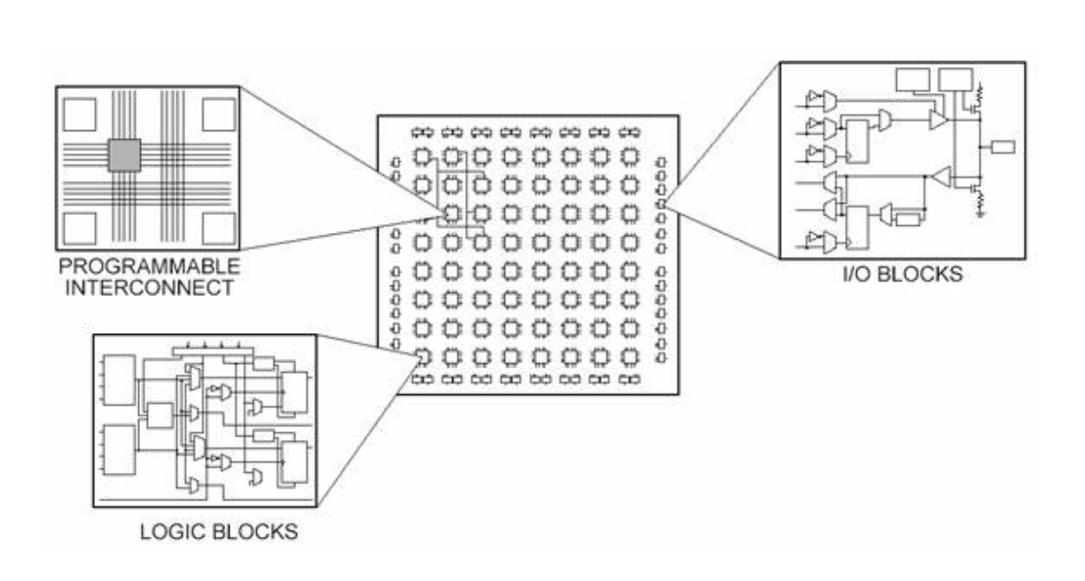
FPGA Hardware Components
Flip Flops
Lookup Tables (LUTs)
Multipliers and DSP Slices
Block RAM (BRAM) [3]
Image 2: FPGA Component Architecture [5]
Notes:
Flip Flops = logical state machine that holds a value (0 or 1) in a latch until the next rising clock edge
LUT = Implementation method of logic gates (AND, OR, NOR, XOR, etc.)
LUTs are majority of the CLB
Mult and DSP = prebuilt hardware multipliers that are often used in digital signal processing algorithms
BRAM = User defined RAM in CLBs

Slide 5
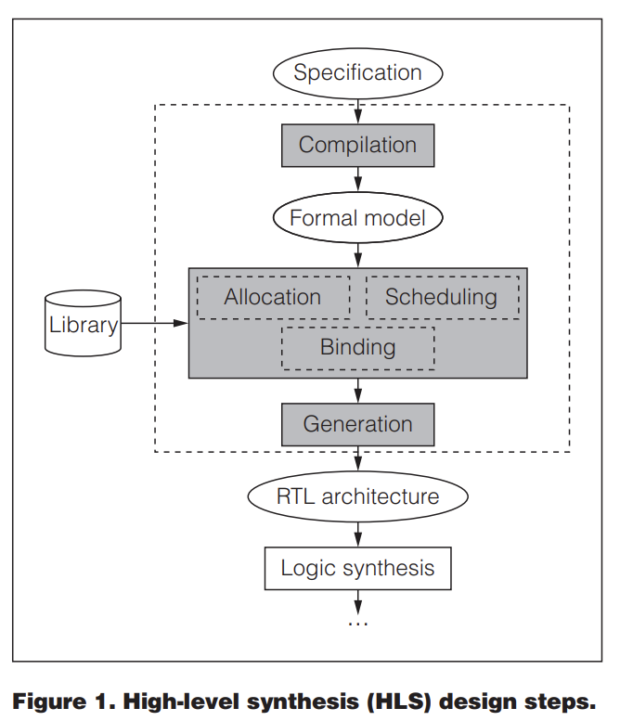
High Level Synthesis (HLS)
Image 3: High Level Synthesis Steps [6]
Notes:
Converts high language level code into a fully timed implementation.
The high-level synthesis process:
compiles specification,
allocates hardware resources (functional units, storage components, buses, and so on),
schedules operations to cycles,
binds operations to functional units,
binds variables to storage,
binds transfers to buses, and
generates RTL architecture. [1]

Slide 6
AMD Tools
Image 4: AMDs HLS Suite [2,3]
Notes:
Vitis is an HLS tool from AMD to generate HDL
Can export a solution to Vivado in Verilog or VHDL
Vivado is an HLS tool from AMD to generate a bitstream

Slide 7
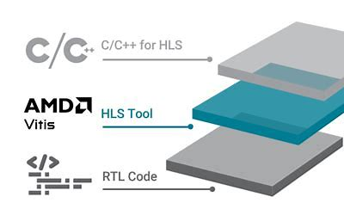
Vitis and Vivado Pipeline
C++
Optimize
Vitis
Synthesis & Implementation
Export RTL
Vivado
Simulation & Synthesis
Bitstream
Generate Bitstream
Jupyter
Pynq Interface
.hwh file
Board
Figure 2: AMD Tool Pipeline [2]

Slide 8
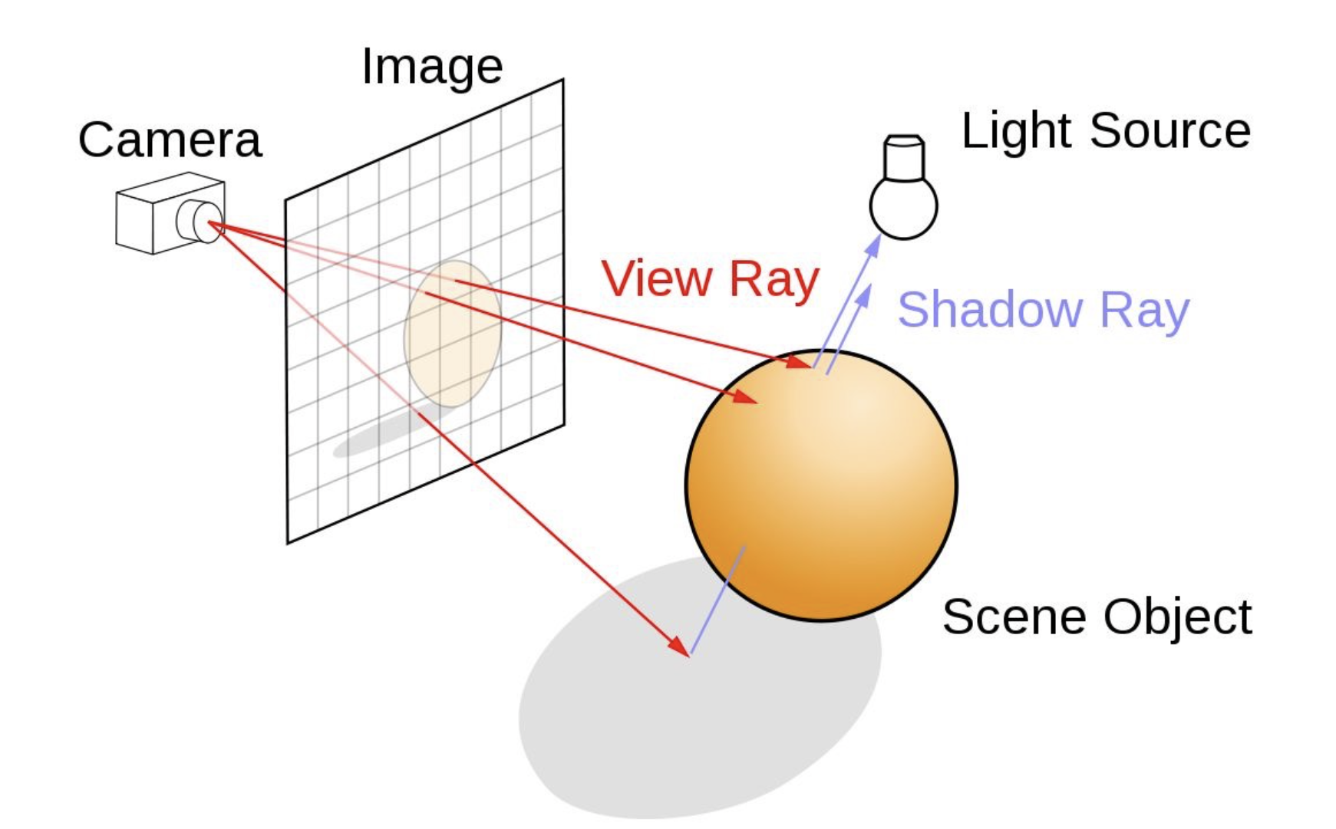
Ray Tracing
High fidelity rendering technique [4]
Image 5: Definition of Ray Tracing [7]

Slide 9
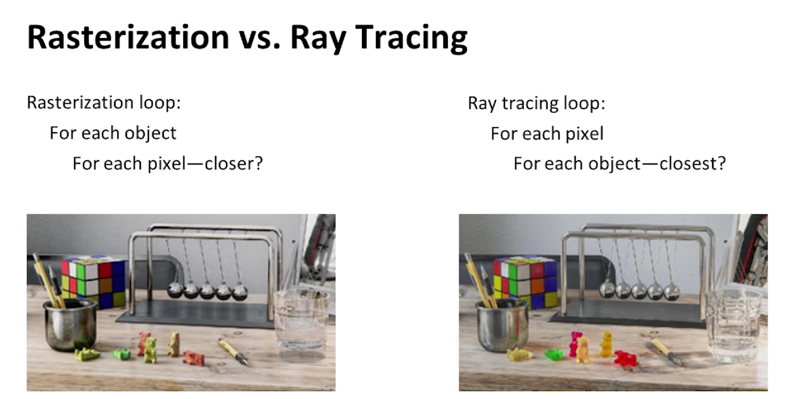
Alternatives to Ray Tracing
Image 6: Differing Rendering Techniques [8]
Notes:
Rasterization has a scene (collection of pixels) and then lays objects on top and takes whatever value is closest to the camera. More efficient, less accurate

Slide 10

Development Plan
Steps | Add | Remove
Recursion
Macros
Pragmas
Hardware Implementation
Table 1: Develop through the Pipeline
Notes:
C++ Optimizations include:
Remove recursion because on board memory implemented as a stack
Remove recursion
Create recursive “straight line” solution
Reconfigure for hardware
Rewrite code
Macros
Updated function prototypes (parameters)
Include pragmas
Use tools to generate hardware code
Port

Slide 11
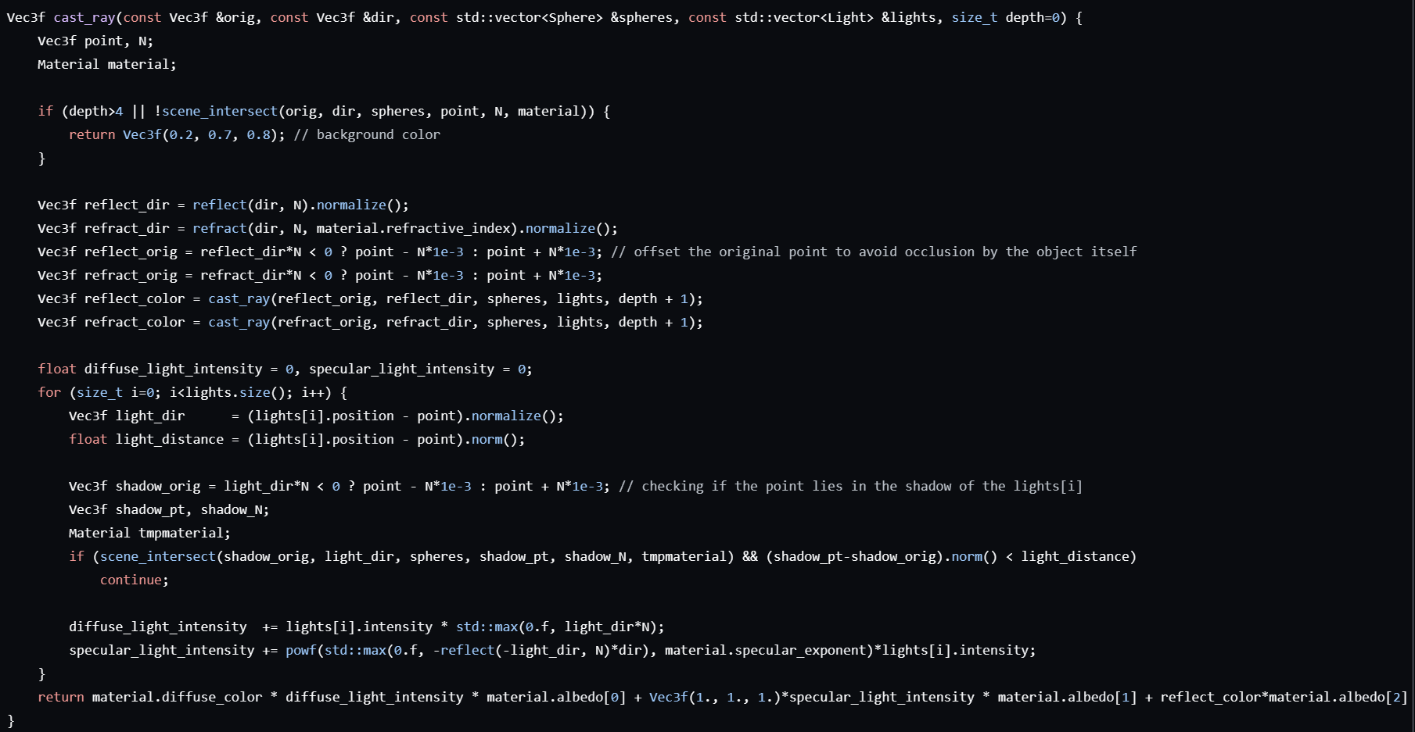
Original Code (cast_ray)
Vec3f cast_ray(const Vec3f &orig, const Vec3f &dir, const std::vector<Sphere> &spheres, const std::vector<Light> &lights, size_t depth=0)
Image 7: Recursive Code

Slide 12
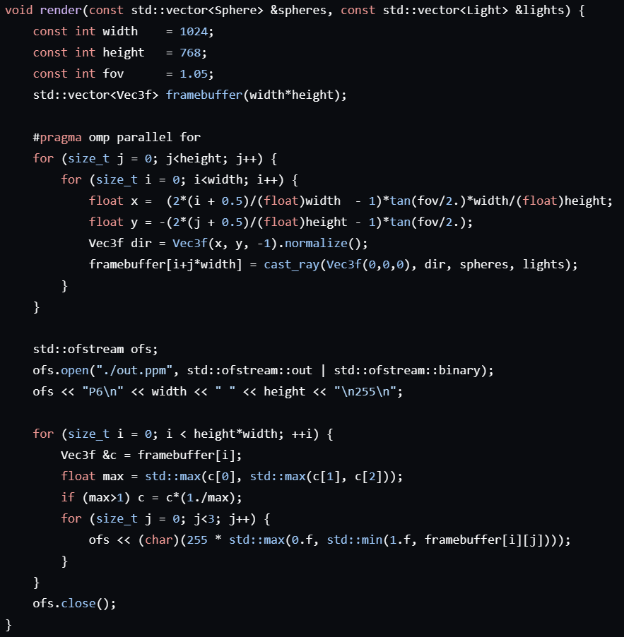
Original Code (render)
Image 8: cast_ray caller

Slide 13
Recursive Ray Tracing Example
Figure 4: Recursive Ray Tracing Example
Notes:
Goes from camera to 2d scene to the blue sphere. At depth 0, once we bounce off blue sphere, it hits base case.
When depth = 1, the ray bounces from the blue sphere to the red sphere. That then returns it value to the blue sphere and the blue sphere then returns its’ value

Slide 14
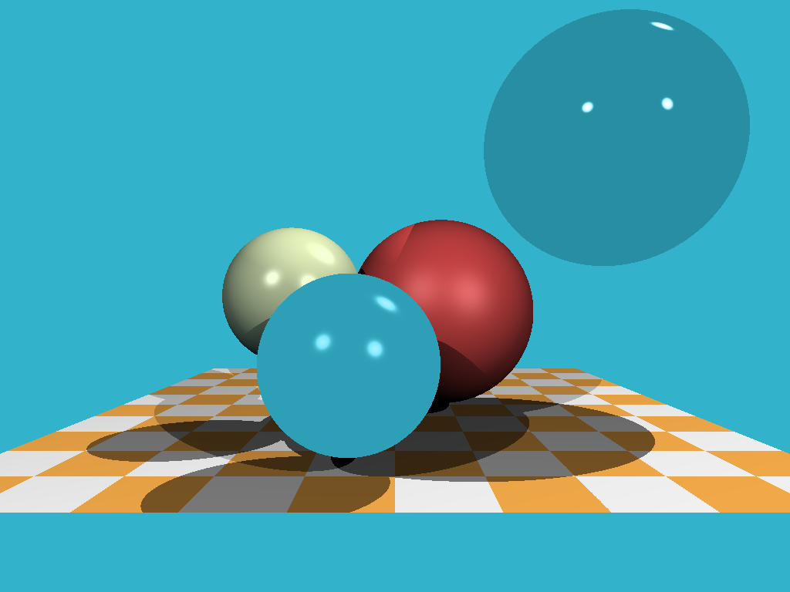
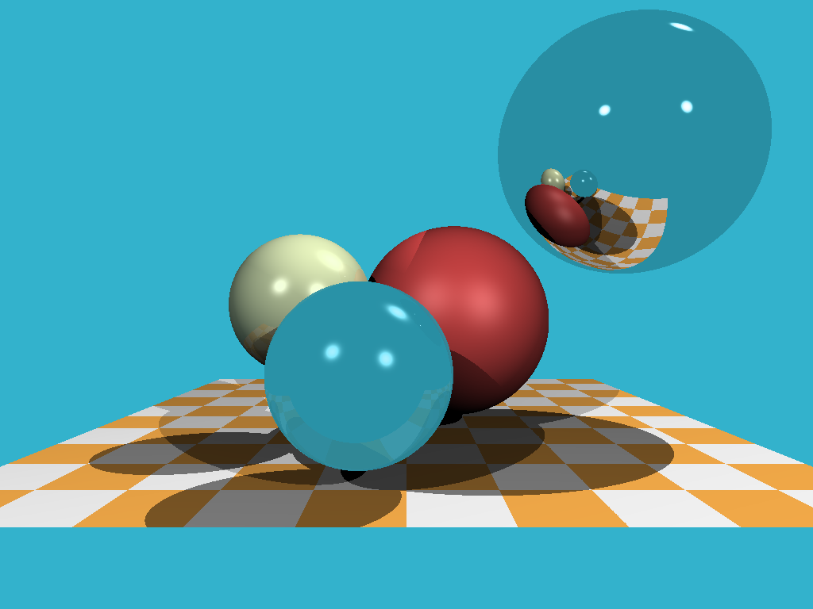
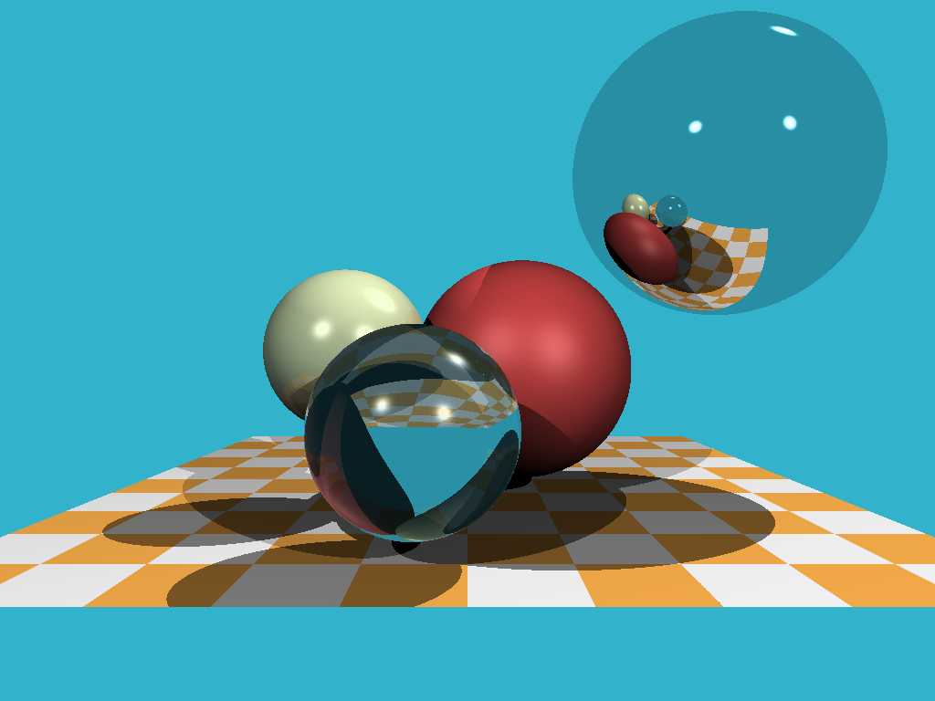

Recursive Outputs of Varying Depths
Depth 0
Depth 1
Depth 2
Depth 3
Image 9: Target Images for Different Depths
Notes:
Obtained by changing depth parameter in base case

Slide 15
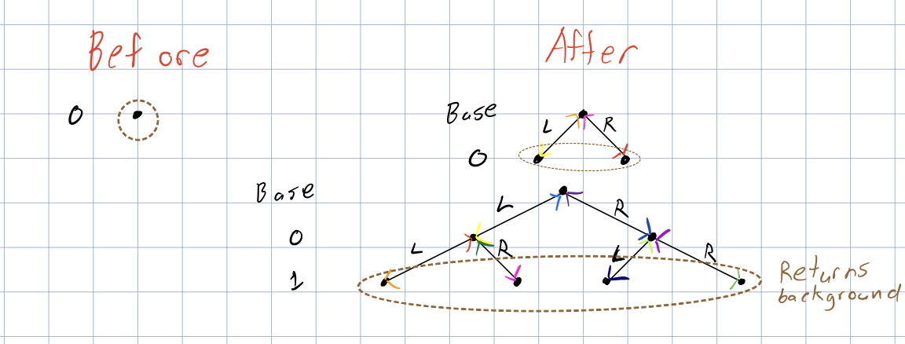
Understand Recursive
Image 10: Notes on Recursive Tree Structure
Notes:
Depth != Height in the tree

Slide 16
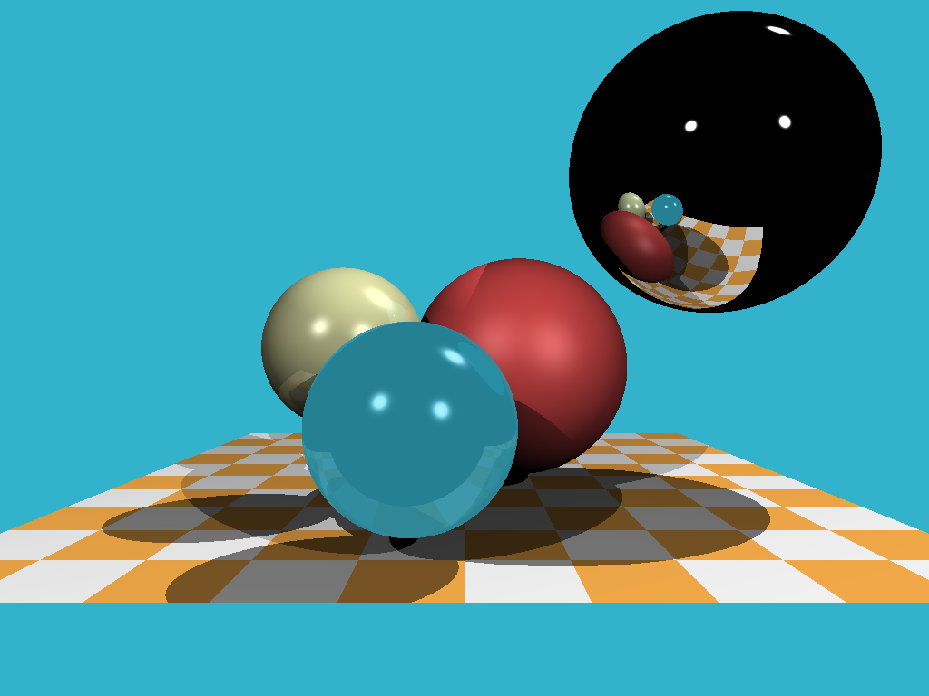
Debug Process
Attempted Solutions
Target Rendering
Depth 0
Depth 1
Image 11: Source vs Depth Matrix

Slide 17
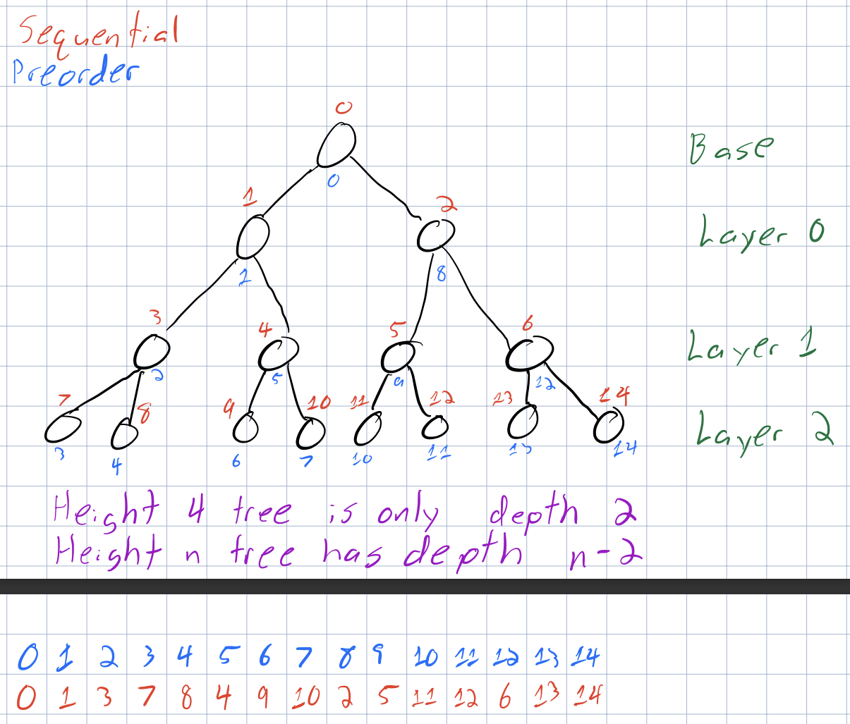
Linearize the Tree Structure
Image 12: Depth 2 Tree Node Ordering
Notes:
Computation is exponentially more costly as depth increases

Slide 18
Create Working Serialized Ray Tracing
Original cast_ray for depth 3:
30 lines of code
New cast_ray for depth 3:
633 lines of code
Image 13: Original vs New

Slide 19
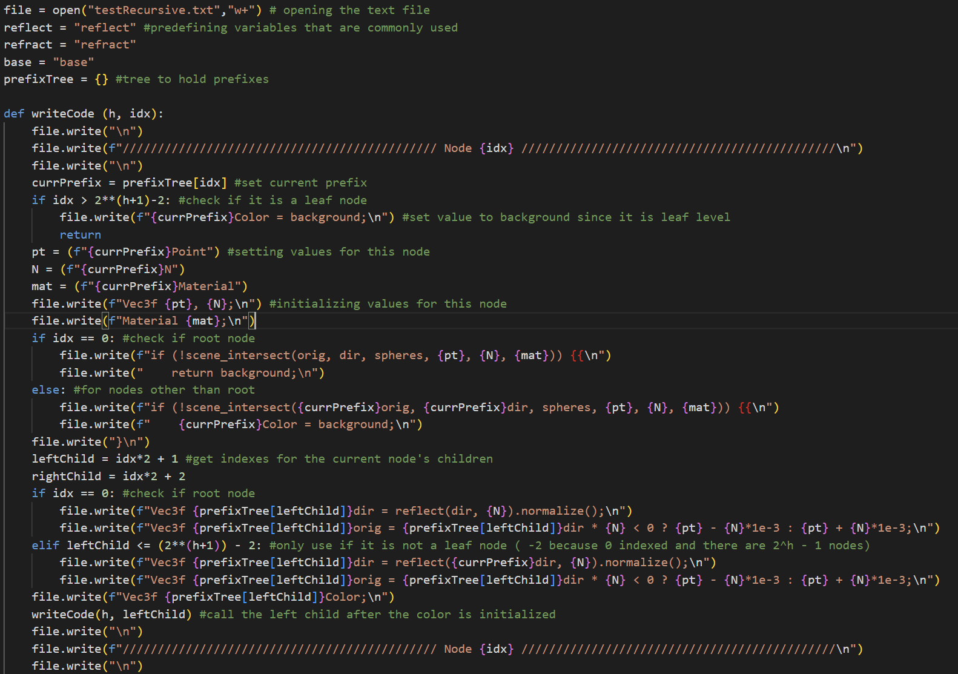
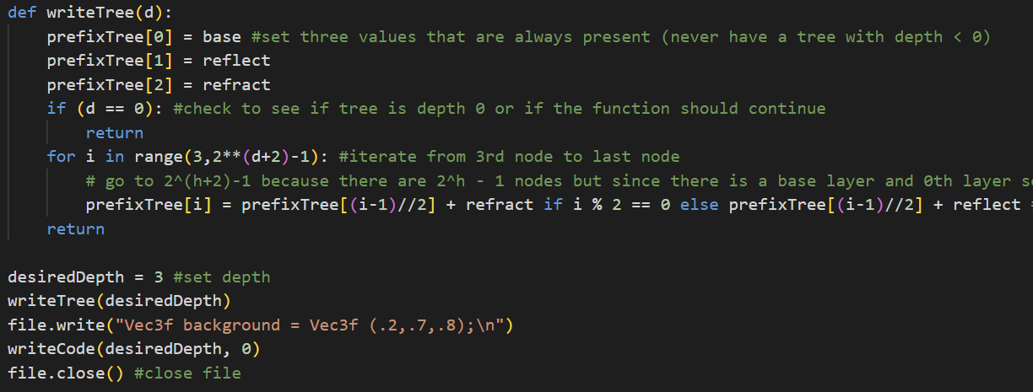
Unrecursivefy.py
Image 14: writeTree() and “main”
Image 15: Portion of writeCode()
Notes:
Mention dynamic variable naming

Slide 20
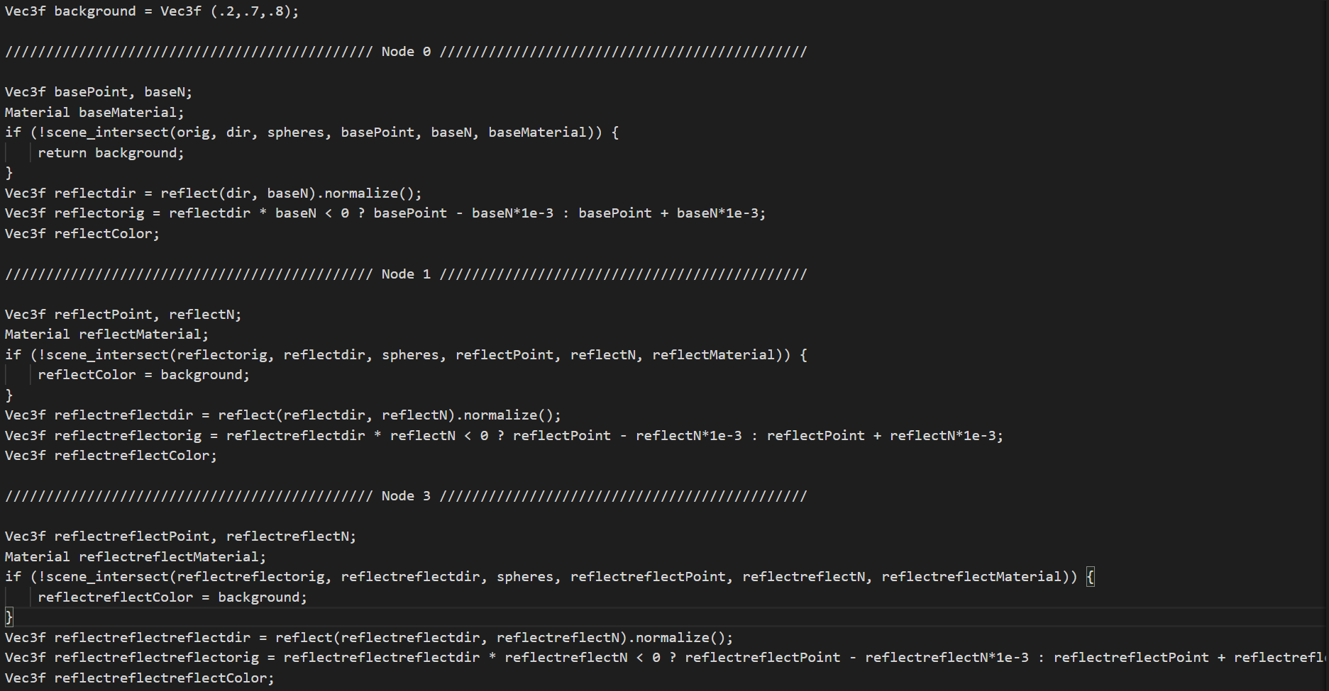
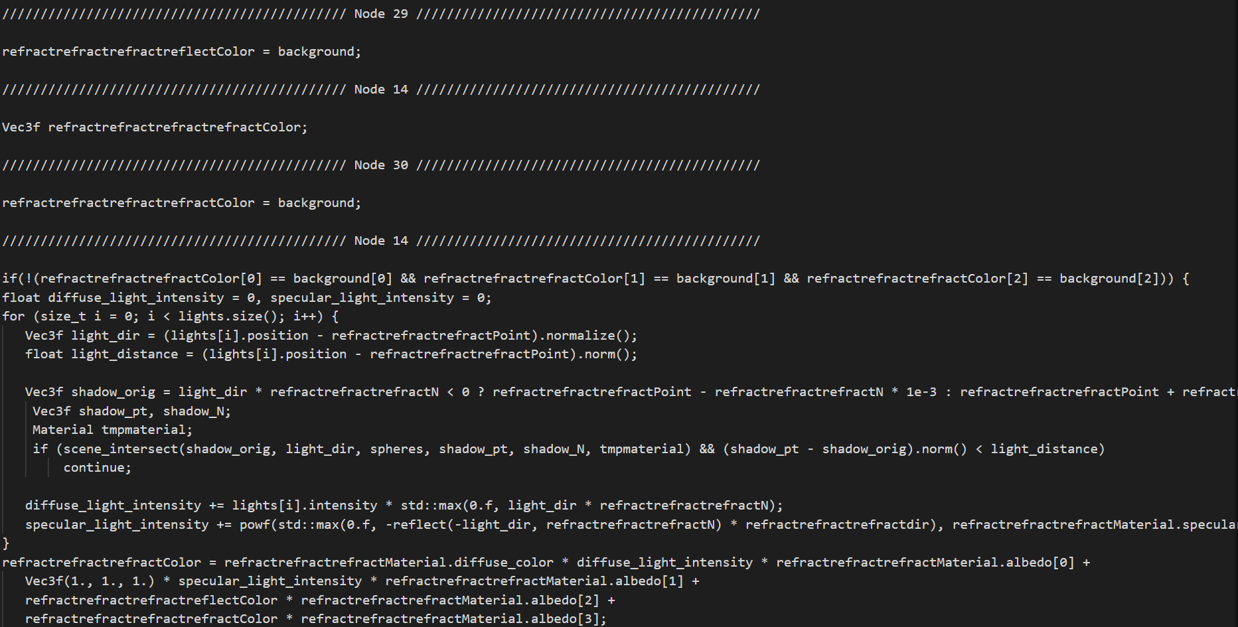
testRecursive.txt
Image 16: Portion of Generated C++ Code
Notes:
One current drawback is output to text file and manually moving code over

Slide 21
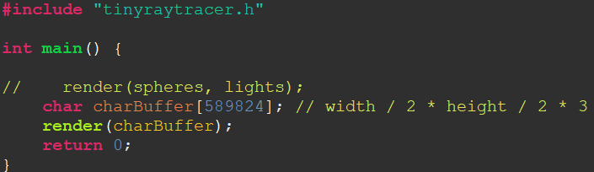
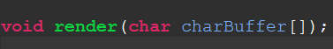
Begin Port
Header File
Testbench File
Image 17: Vitis Testbench File
Image 18: Vitis Header File
Notes:
Testbench contains main() method and header file contains prototype for the top function

Slide 22
Struct Updates
float albedoX
float albedoY
Vec4f albedo
float albedoZ
float albedoW
Figure 4: Struct Revisions
Notes:
This is just one part of Material, Sphere, and Light were also updated. Comments indicate where the old code was replaced. Also updated the constructor to take in 3 arguments instead of 1 Vec3f but not commented

Slide 23
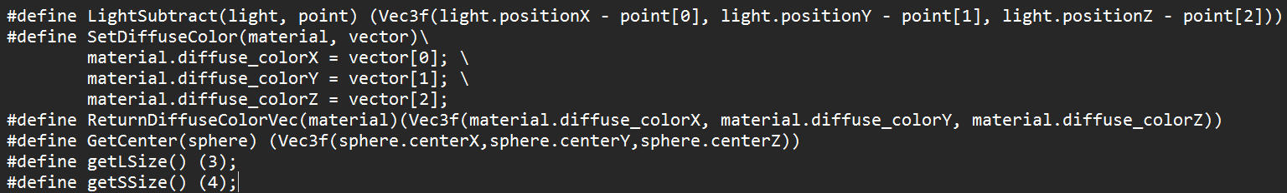
Macros
Using Vec3f from “geometry.h” had issues
Considered double pointer inside of structs
Image 19: tinyraytracer Macros
Notes:
Some structs used Vec3f as the data type for some of their attributes Needed a way to perform operations with locally defined Vec3fs and our 3 float values
ALSO, mention double pointers are a problem because they cannot be implemented with a stack memory

Slide 24
Pragmas Used
Operation | Variable | Op | Latency | II | Status
BIND_OP | sqrt_k | fsqrt | 24
INLINE |  |  |  |  | OFF
FUNCTION_ INSTANTIATE | dir
PIPELINE |  |  |  | 24
LOOP_FLATTEN
Table 2: Pragmas and their Parameters
Notes:
BIND_OP (variable, op, latency) = a specific variable is mapped to a specific operation on specific device resource for implementation and should take around latency many cycles
INLINE OFF = decreases area because inlining functions cannot be shared or reused
FUNCTION_INSTANTIATE (variable) = maintains function location and can perform targeted local optimizations thus improving latency and throughput
PIPELINE (II) =
LOOP_FLATTEN = allow nested loops to be flattened into a single loop with improved latency

Slide 25
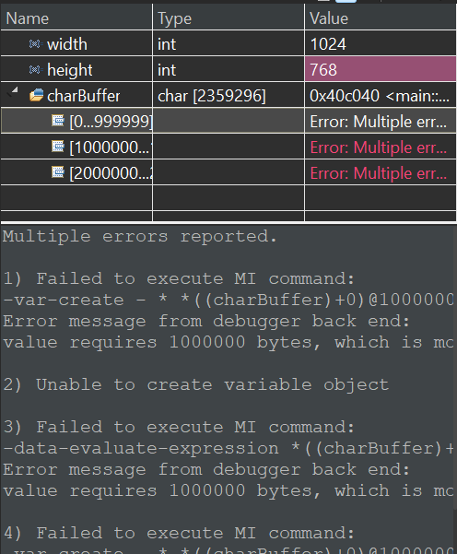
Memory
Normal image too big for memory
Cannot write to output file on board
Image 20: Memory Size Error
Notes:
Divided image in half in both dimensions (instead of 1024*768*3)

Slide 26
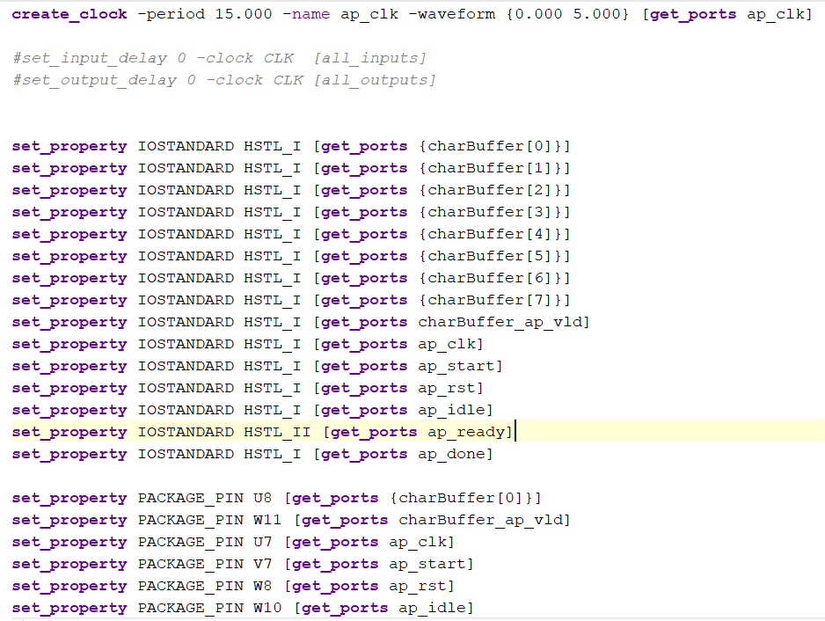
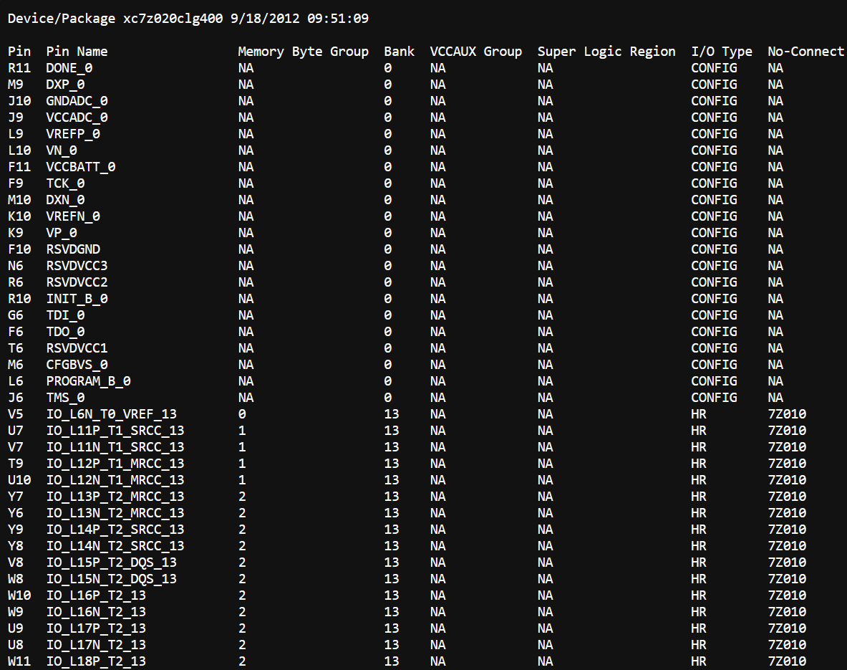
Setting Pins
Had to write constraints file
Including values (upper portion)
And pins (lower portion)
Image 20: Setting Values Inside Constraint File
Notes:
Box in red shows pins in specified location I found using Vivado (so, only look at bank 13 pins to set logical ports to)
First time in Vivado, no location and no value for logical ports
Also needed to update period to increase slack

Slide 27
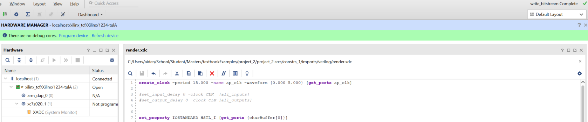
Generated Bitstream
Image 21: Connecting Bitsrteam to Hardware
Notes:
Program device here kills jupyter and does not work. Actual method all through jupyter

Slide 28
Future Work
Allow for more / new objects
Further optimize Vitis (more pragmas and increase memory)
Update ray tracer to work in real time
Automate more tasks
Find .hwh file to implement on board
Notes:
“Update for real time” = basically a video turning around a scene (cite Sokolov has done it already)
“Automate” = create makefile to run unrecusivefy and have it get plugged in to cast ray programmatically instead of copy-paste

Slide 29
References
[1]: “C++ Logo Image PNG Transparent Background, Free Download #28389 - FreeIconsPNG,” freeiconspng.com. https://www.freeiconspng.com/img/28389
[2]: “Vitis HLS,” Xilinx, 2023. https://www.xilinx.com/products/design-tools/vitis/vitis-hls.html
‌[3]: “[Icon Request] Vivado Design Suite · Issue #1615 · PapirusDevelopmentTeam/papirus-icon-theme,” GitHub. https://github.com/PapirusDevelopmentTeam/papirus-icon-theme/issues/1615
‌[4]: Notebookcheck.net, 2024. https://www.notebookcheck.net/fileadmin/Notebooks/News/_nc3/01_pynq_z2.jpg
[5]: “FPGA Fundamentals: Basics of Field-Programmable Gate Arrays,” www.ni.com. https://www.ni.com/en/shop/electronic-test-instrumentation/add-ons-for-electronic-test-and-instrumentation/what-is-labview-fpga-module/fpga-fundamentals.html
[6]: P. Coussy, D. D. Gajski, M. Meredith and A. Takach, "An Introduction to High-Level Synthesis," in IEEE Design & Test of Computers, vol. 26, no. 4, pp. 8-17, July-Aug. 2009, doi: 10.1109/MDT.2009.69.
[7]: Nvidia, “Ray Tracing,” NVIDIA Developer, Aug. 14, 2018. https://developer.nvidia.com/discover/ray-tracing
[8]: “Ray Tracing Essentials Part 2: Rasterization versus Ray Tracing,” www.youtube.com. https://www.youtube.com/watch?v=ynCxnR1i0QY&list=PL5B692fm6--sgm8Uiava0IIvUojjFOCSR&index=2

Slide 30
Special Thanks
Dr. Richard Veras
Moez Khan
Dr. Dmitry Sokolov
Mrunal Krishna Sarma Aryasomayajula

Slide 31
Questions?

